Slide 1
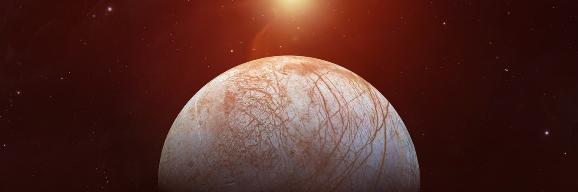


relative age algorithm
Europa Moon^{[l]} by Unknown Author, Clovis Community College Logo^{[l]} by Clovis Community College, and NASA Logo^{[l]} by NASA are licensed under CC BY.
Joshua Lin

Slide 2
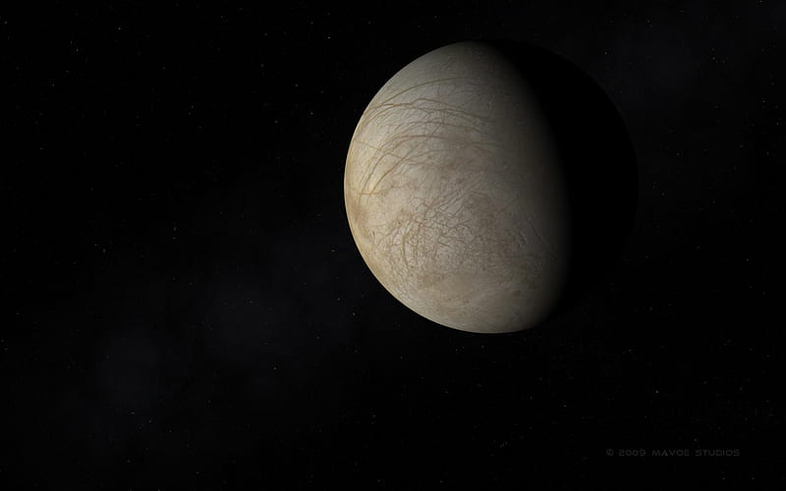
The question
Given…
The relevant bands to be considered,
The youngest band at each intersection,
Confidence level of each intersection
Can we develop a system to accurately rank the relative ages of the bands & lineaments from youngest to oldest?
Europa^{[l]} by Unknown Author is licensed under CC BY.

Slide 3
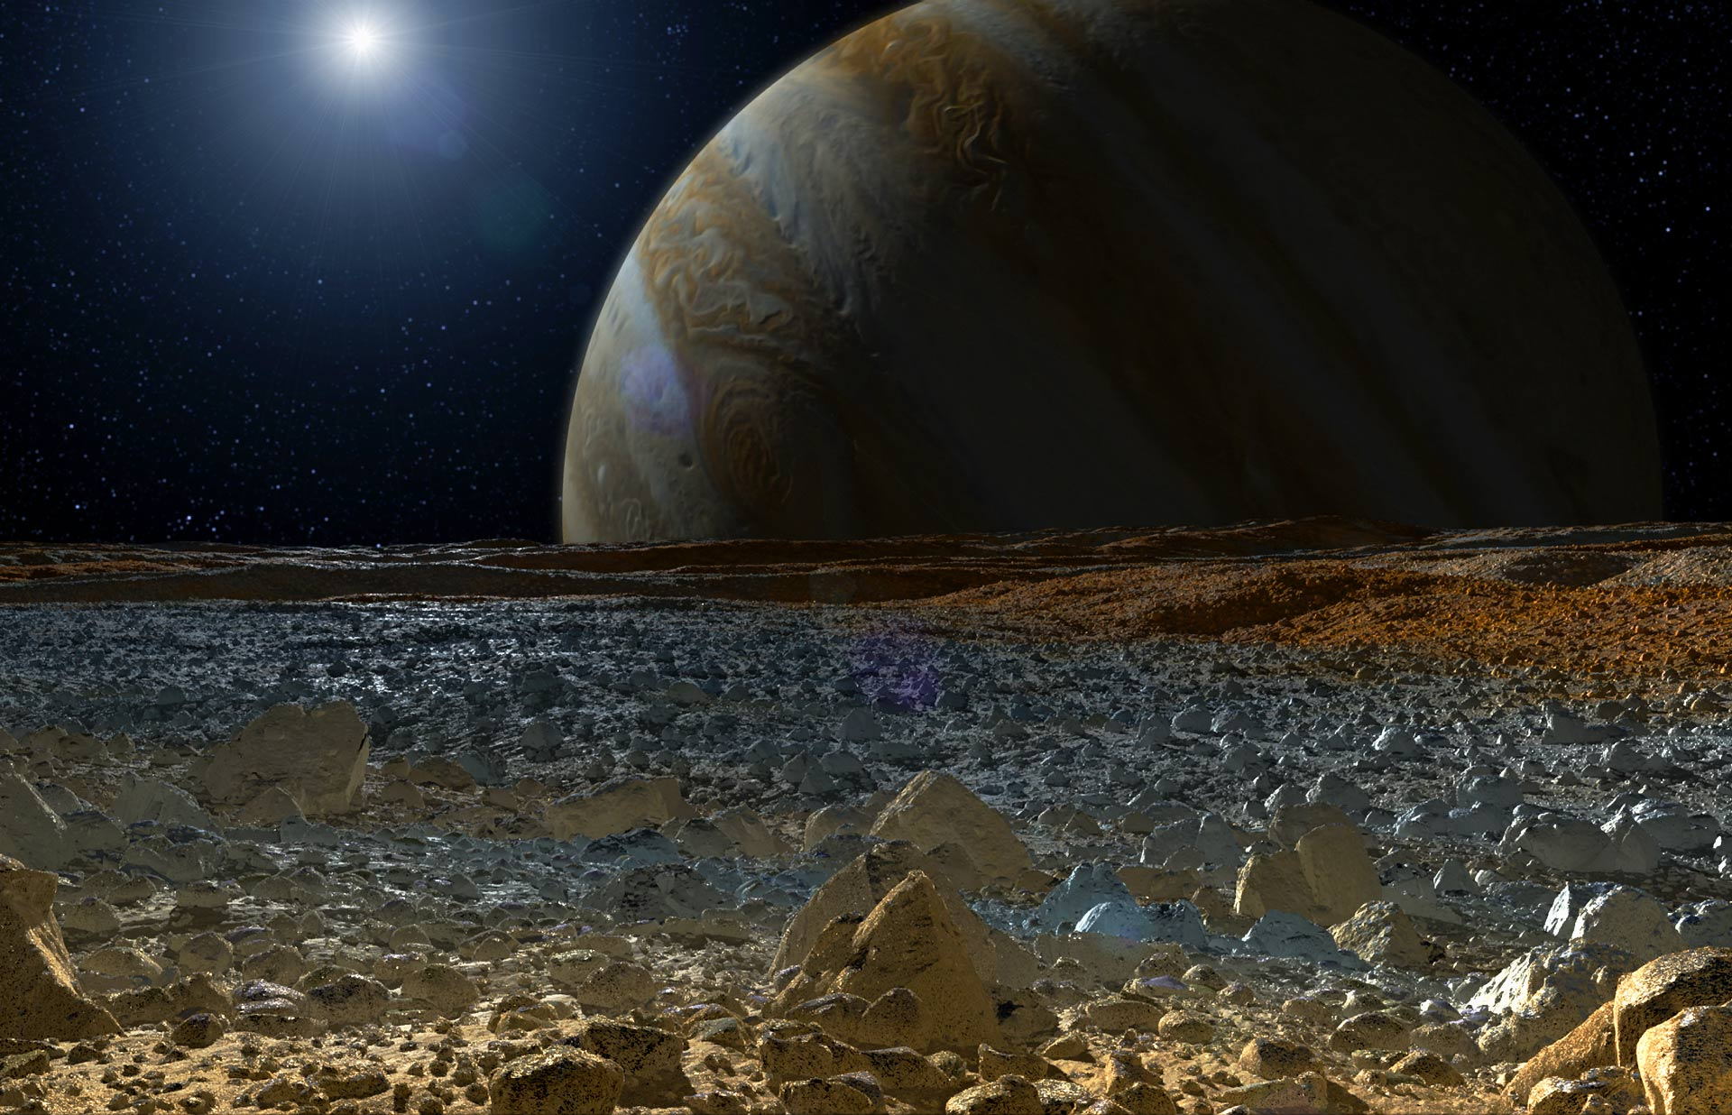
RELEVANCE
Europa^{[l]} by John S. Howard is licensed under CC BY.
Why is it vital to ascertain the relative ages of large band networks? It allows...
Correlations between age and other morphological parameters of interest to be studied
Geologic reactivation to be more readily identified and investigated

Slide 4
Background Information
Challenge: Band network may be an underdetermined system.
Language: Python
Main CS Principles Applied:
Depth-First Search + Topological Sort
Kosaraju’s Algorithm for Strongly Connected Components
Physics Principles:
Geologic Reactivation—creates cycles within sorted orderings, such as Band1 > Band2 > Band3 > Band1

Slide 5
inputs
bands
List of relevant bands to be sorted (all others will be ignored)
intersections
Type: List[Tuple[str]]
List of intersections.
Solution #3
List[int]
List of confidence levels for each intersection.
Type: List[str]
Tuple format: (top, bottom1, bottom2, …, bottomN)
Bottom bands are not in any particular order.
Must be in same order as `intersections`.

Slide 6
The `BandNetwork` Class
Instance Variables: bands, intersections, and confidences (as defined previously).
Sort Methods:
top_sort(): Finds an ordering that fits all constraints. If there exists a unique system, it will be found.
calculate_accuracy(): Removes one band at a time, then find mean-squared error from shifted indices.
Cycle Detection Methods:
check_cycle(): Applies DFS to determine whether reactivation is present.
find_cycle(): Applies Kosaraju’s Algorithm to find all reactivation cycles (i.e., SCC of length > 1).
break_cycle(): If a cycle exists, remove lowest CL bands (one level at a time) until resultant topological sort has no reactivation cycles.

Slide 7

Discussion
Usage: Because top_sort() is always strictly ordered only for networks with at least $N−1$ intersections for $N$ bands, calculate_accuracy() is valuable for considering how “good” the output ordering is (i.e., amount of deviation).
Therefore, this program may be most useful…
1) in tandem with human analysis, providing an initial framework of orderings, and
2) locating specific bands that form reactivation cycles, which may then be resolved automatically or manually.

Slide 8
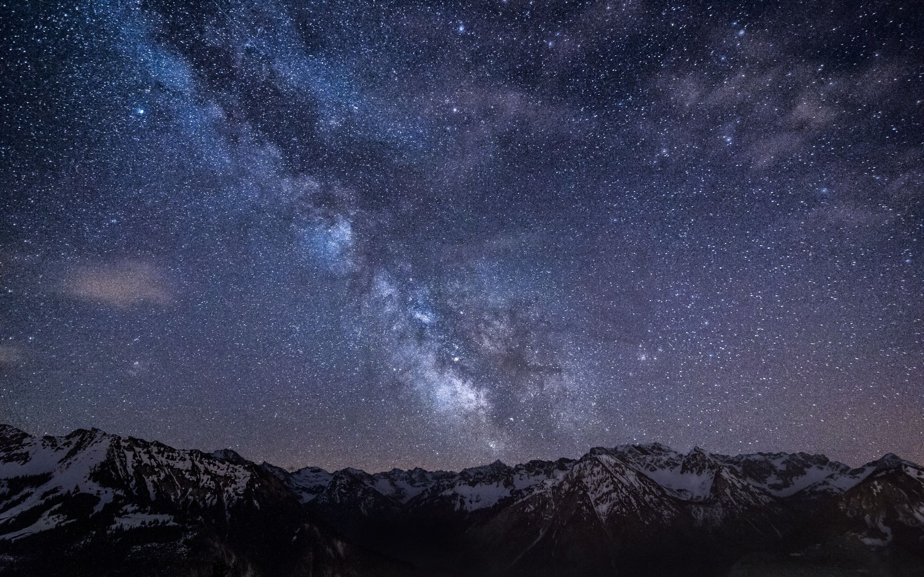
Next Steps
Add alternative sort methods, such as sort that outputs all subsets of the bands with strictly determined ages, or a probabilistic sort.
Improve compatibility by allowing data to be read from CSV files.
Create accessibility from JavaScript/HTML app so that program need not be run from command line.
Mountains Night Sky^{[l]} by Unknown Author is licensed under CC BY.

